Slide 1
NLP & Text Analytics
Group 6: Anvesh Mateti, Anand Surya Rajasrinivasan, Muriel Banze

Slide 2
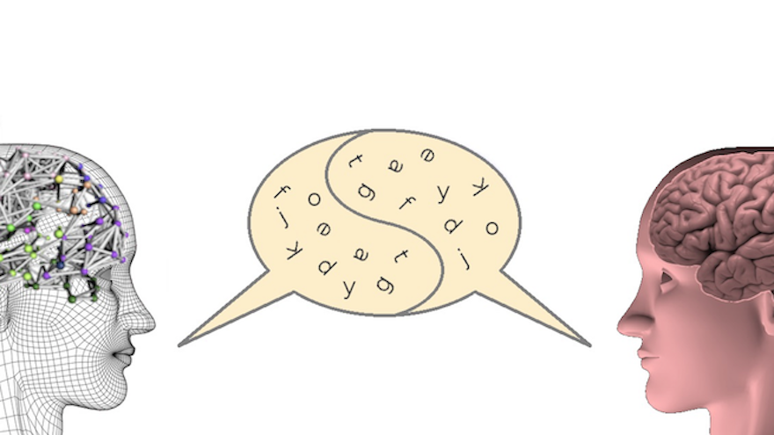
Language
Language is the expression of ideas
Why is language hard for computers?
Language is imprecise
Contextual words:
“Bill can run faster than Bob”
“This house is run down”
Idioms and ambiguity:
”The exam was a piece of cake”
Notes:
Language is how humans understand things. It is how we think, imagine, and speculate. Language is how we interpret ideas and discuss information among ourselves. However, why is language not easy for a computer? Why you may ask? Well language is imprecise. It is full of idioms and ambiguity. Suppose someone says “the exam was a piece of cake”. This means something is easy! However, for a computer, this would difficult to understand without context. * Example of contextual words *Other challenge for computers from human language are irony and sarcasm

Slide 3
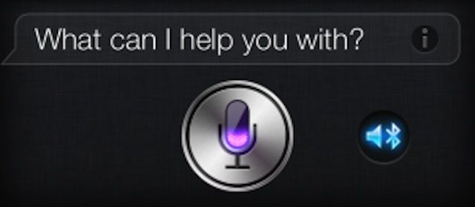
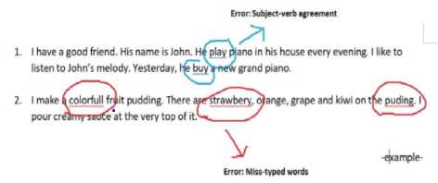
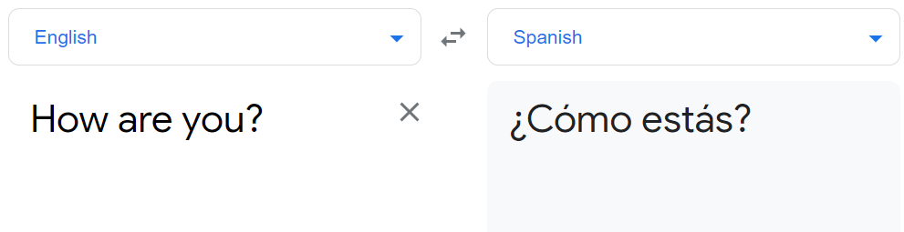
Natural Language Processing
Branch of AI that helps computers understand human language
Use cases:
Personal assistant applications like Siri, Google and Alexa
Language Translation Applications (Google Translate)
Word Processors such as Microsoft Word
Notes:
NLP -
So how do we get computer to understand human language?
Through NLP, which is a branch of Artificial Intelligence that helps machines to be able to interpret and understand human language. The main idea behind Natural Language Processing is to make a machine read, decipher, understand, and make sense of human language in a way that is valuable to us. NLP is used in various everyday devices. Think about the personal assistant applications we use such as Siri, Google, or Alexa. These services use NLP algorithms to answer questions. NLP is also used in Google Translate to help easily translate from one language to another. NLP is also used in word processors when we make grammar or spelling errors, NLP solves our problems.

Slide 4
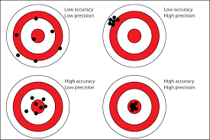
Precision vs Accuracy
Precision: scientific exactness that can be found in a passage of text
Accuracy: degree in which one passage infers another passage to be true by another person.
Notes:
Precision vs Accuracy
Precision is th

Slide 5
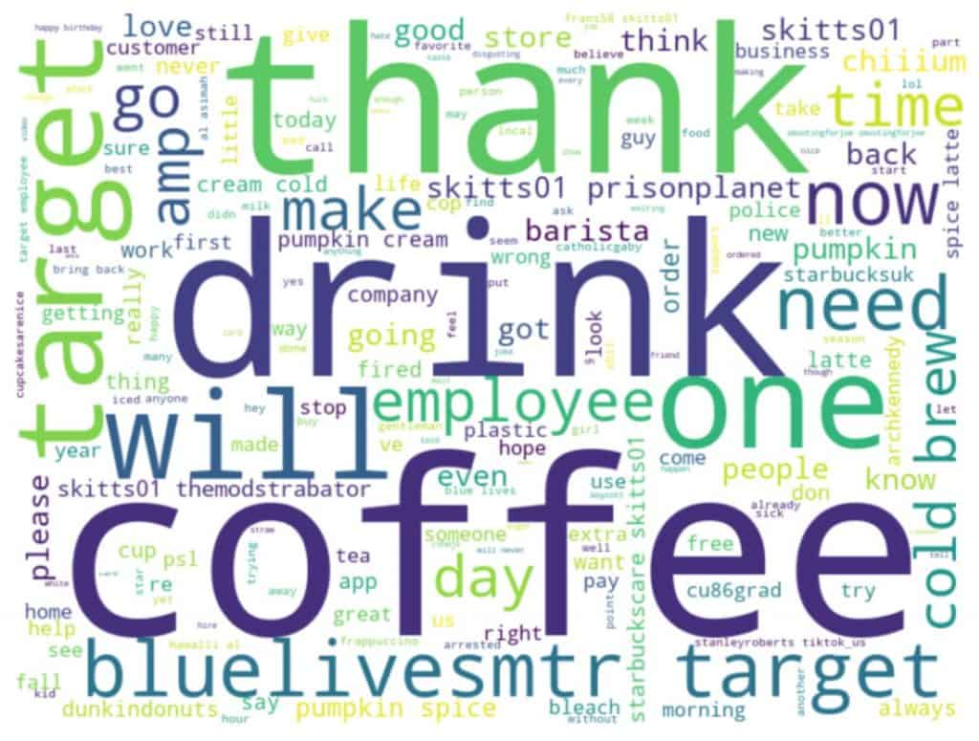

Shallow NLP
Precision is emphasized over accuracy
Use cases:
Sentiment Analysis - classification of emotions in a set of data
“Pizza is great” (+1)
“pizza is tasty” (+1)
“It’s great there is a new pizza place in town, however I rather eat at Dominos (-1)
Limitation:
Brittle - perform well in narrow parameter, bad with changing parameters
Notes:
There are two techniques in natural language processing that are for knowledge extraction. Shallow and Deep NLP.
In Shallow NLP, precision is emphases over accuracy with a set of specific well formed rules.
Shallow NLP is used in sentiment analysis. Sentiment analysis is the classification of emotions in text data.
Useful for looking at trends over huge quantities of information.
For example, we can look for specific words form a social media site, like twitter.
Limitation of Shallow NLP is that they are brittle, they do well in narrow parameters but bad when parameters change.
An example of this would be when you or

Slide 6
Deep NLP
Accuracy is emphasized over precision
Use cases:
IBM Watson - question-answering computer system capable of answering questions posed in natural language
Example: “Treasury Secy. Chase just submitted this to me for the third time - guess what pal, this time I'm accepting it.”
Limitation:
Computationally expensive
Notes:
IBM watson is a deep NLP system
Archives accuracy by assessing a context as much as possible
Can get context from a passage called a knowledge base that it is available for finding responses
This knowledge base also called corpus

Slide 7
Comparison chart
Shallow NLP | Deep NLP
Precision is emphasized over accuracy | Accuracy is emphasized over precision
Useful for finding general trends | Useful for finding exact meaning of a individual example
Computationally inexpensive | Computationally expensive

Slide 8
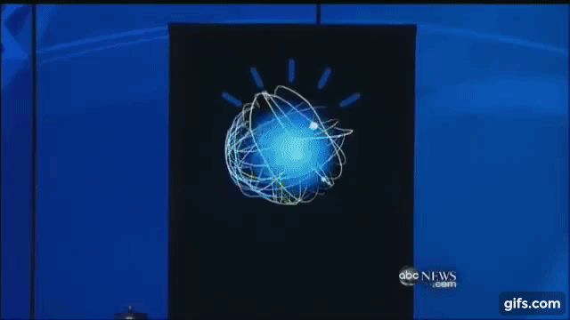
IBM Watson
Introduced to the world in the game show Jeopardy in 2011.
Large corpus:
Unstructured Data:
Textbooks
Research Papers
Manuals
Used in healthcare, chatbot, weather forecasting, teaching assistant.
Notes:
IBM Watson - is artificial intelligence that used to help organization predict future outcomes and automate complex processes.
Appeared on Jeopardy in 2011
Understadn teh features of language used by people.
Determine wether one text passage infer another text passage with high accuracy
In

Slide 9
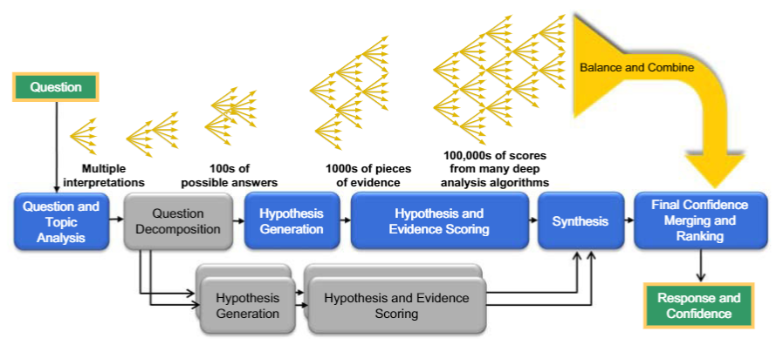
IBM Watson
Figure 1: How Watson derives a response
Notes:
So How does IBM watson work in the background?
IBM watson first takes a question

Slide 10
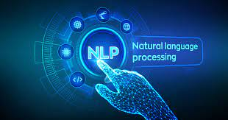
Trends in NLP
Multilingual NLP
Sentiment Analysis
Marketing Intelligence Monitoring
Customer Product Recommendation

Slide 11
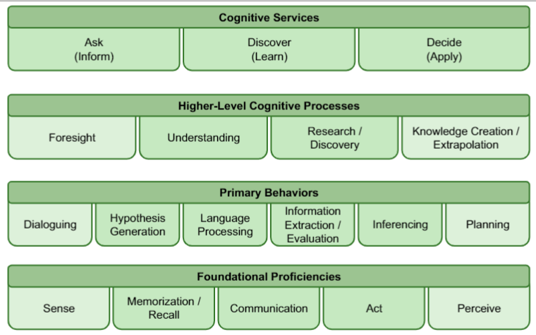
Elements of Cognitive System
Cognitive System: any technology that uses NLP to extend or magnify human expertise and cognition
Notes:
Cognitive systems are any technology that uses NLP to extend the human experience. For example, IBM watson is a cognitive system. Cognitive systems should provide cognitive services such as being able to ask, discover, and make decisions. In his figure the dark boxes show the capabilities of cognitive systems today, and the light boxes show the cognitive capabilities that should be available in the future.

Slide 12
Big Data Analytics and Business Intelligence
Xiang, Zheng & Schwartz, Zvi & Gerdes, John & Uysal, Muzaffer. (2014). What can big data and text analytics tell us about hotel guest experience and satisfaction?. International Journal of Hospitality Management. 44. 120-130. 10.1016/j.ijhm.2014.10.013.

Slide 13
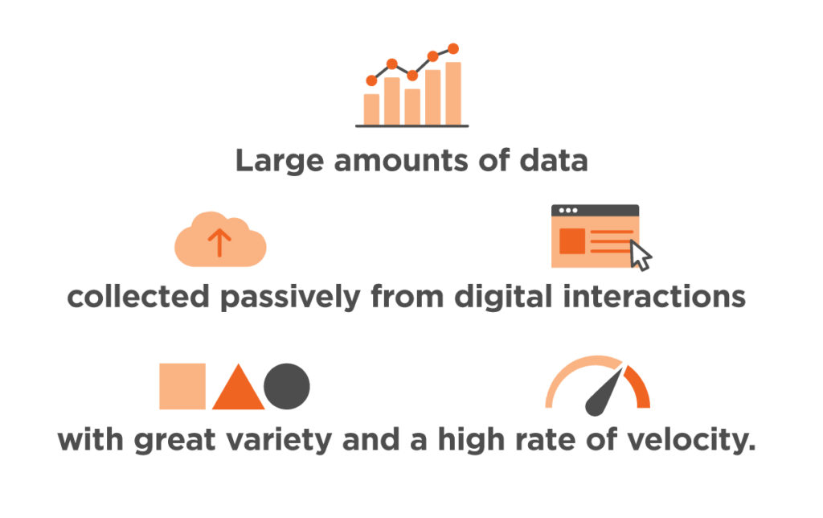
What is Big Data?

Slide 14

What is Big Data Analytics?
Process
Big Data
Patterns, Decision etc,.

Slide 15
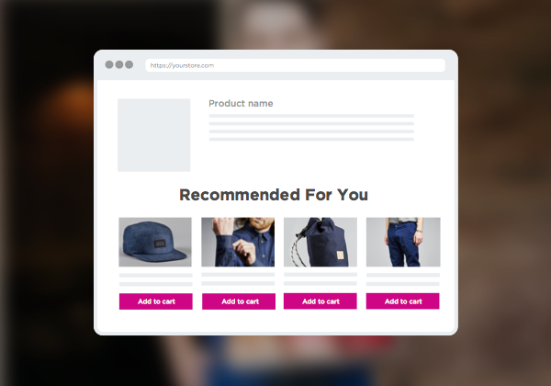

Business Intelligence
Analyze Data generated from a business.
Understand customers, competitors and their product’s impact.
Examples:
Product Recommender
Product Quality from reviews

Slide 16
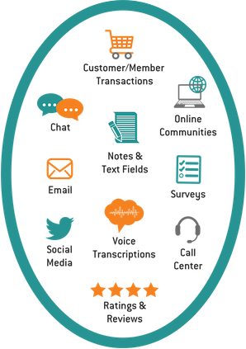

Text Analytics in Business Intelligence
Natural Language Processing
Information Retrieval
Information Extraction
Sentiment Analysis
Unstructured Data

Slide 17
Text Analytics in Business Intelligence
How Text Analysis works?
Data Sources
Preprocessing
(Tokenization, Stop words removal, Stemming)
Analysis
Visualization
Preliminary Formatting

Slide 18
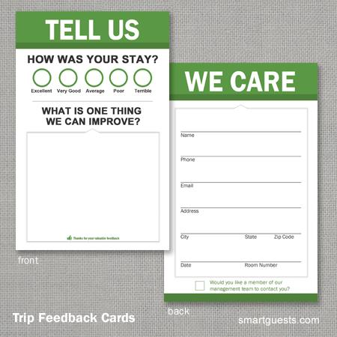
Hotel Guest Experience and Satisfaction
Guest Satisfaction study started in the early 1970s.
Satisfaction = customer experience pre and post purchase of a product or service.
Understanding Guest satisfaction is a complex process.
Common method:
Comment cards

Slide 19
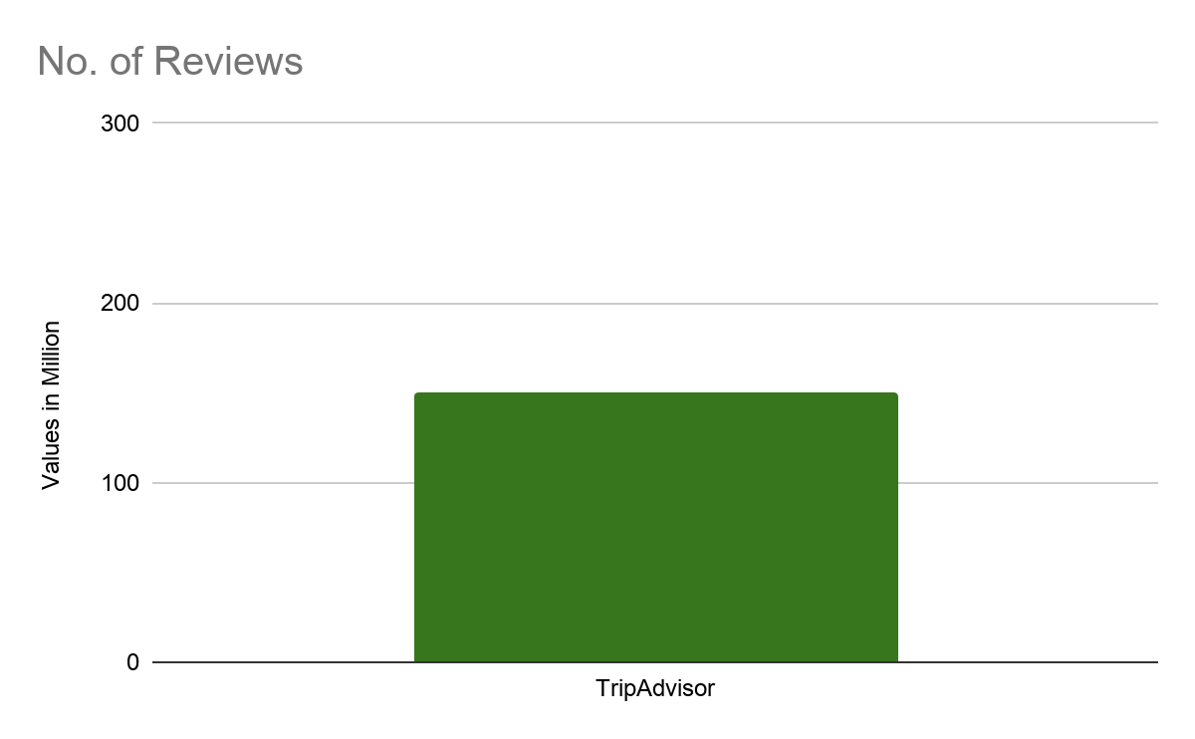
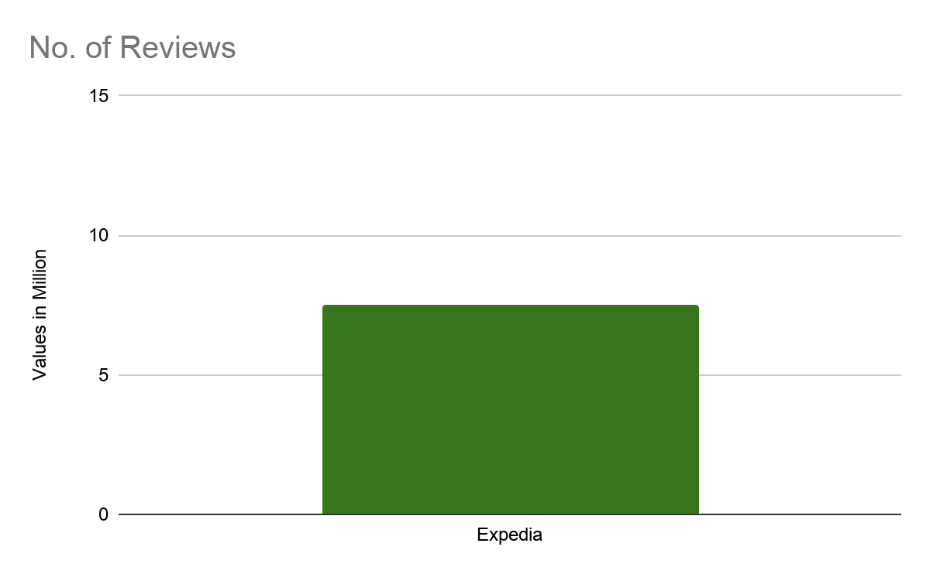
Hotel Guest Experience and Satisfaction
Online reviews are the most influential user generated content.
TripAdvisor.com, Expedia and Travelocity allow users to post reviews of their stays.

Slide 20
Hotel Guest Experience and Satisfaction
Research Questions:
What is the nature and underlying structure of the hotel guest experience represented in customer reviews?
Can hotel guest experience represented in customer reviews be used to explain guest satisfaction?

Slide 21
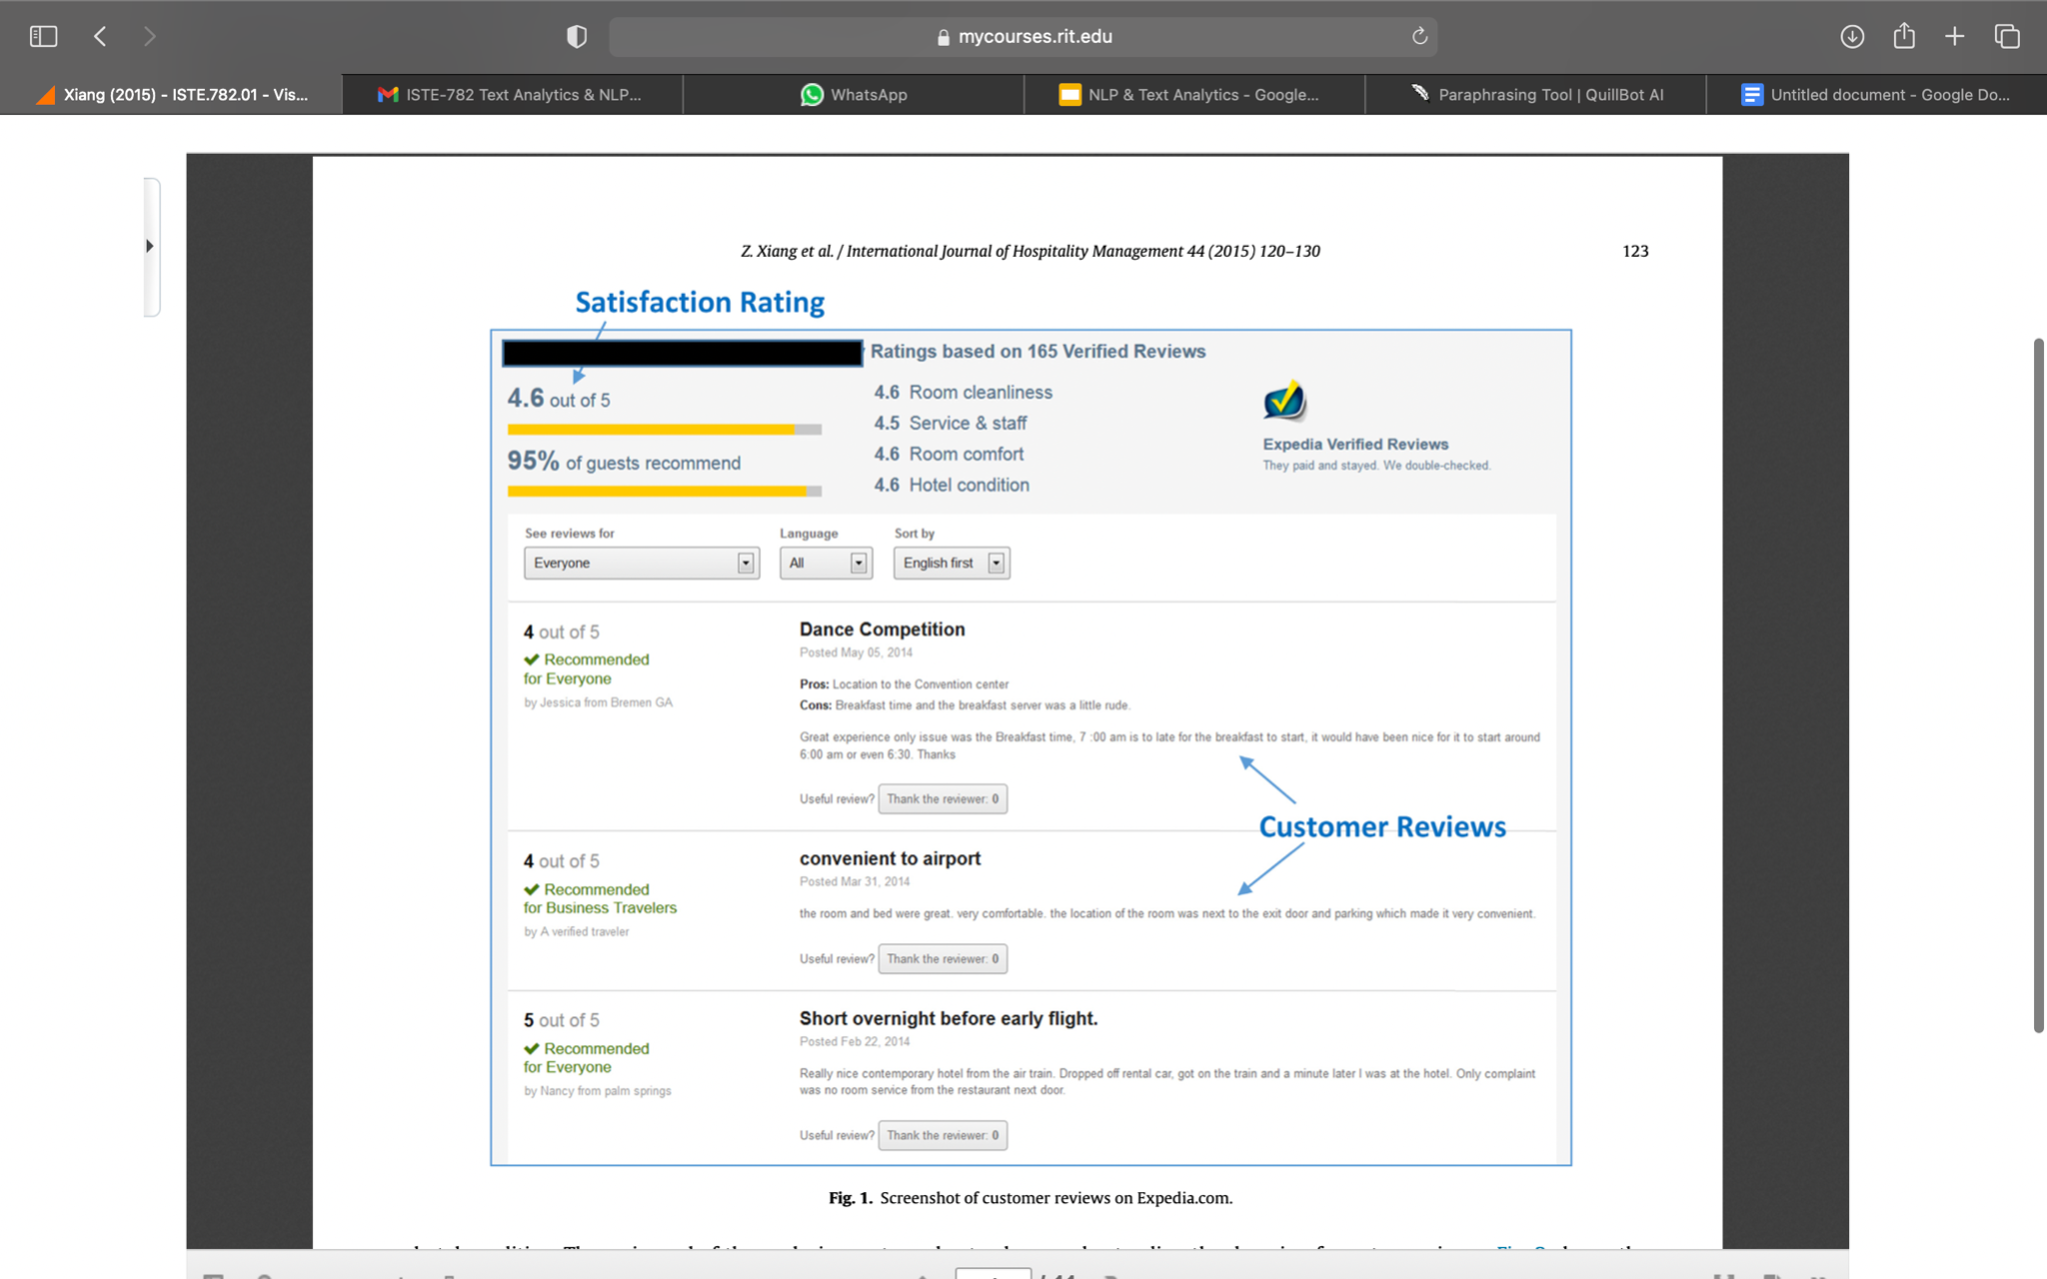
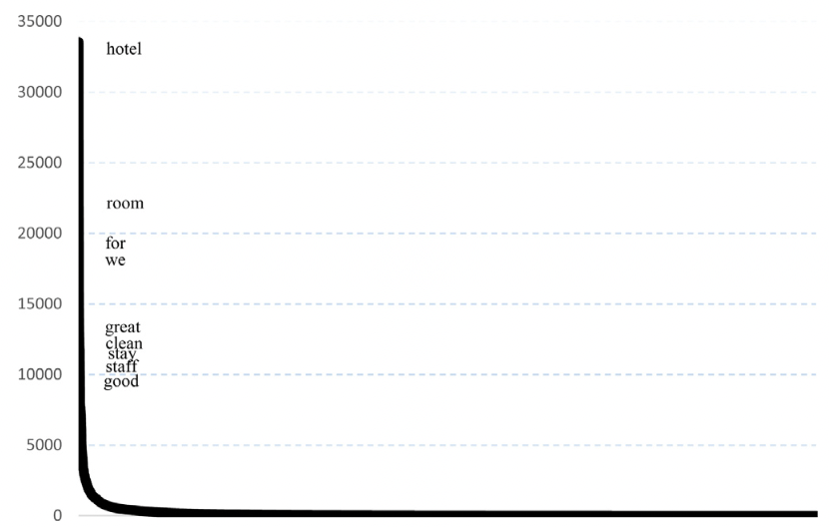
Methodology - Research Design and Data Collection
Goal: Analyze hotel guest satisfaction based on customer reviews in relation to guest satisfaction
Expedia.com data was used to conduct large-scale text analytics (16.5 million visitors) (Fig 2.)
Data for the 100 largest US cities was collected using a Web crawler from the 18th-29th of December.
(Hotels: 10,537 , Reviews: 60,648, Unique Words: 6642) (Fig 1.)
Fig 1. Distribution of word bank based on frequency
Fig 2. Customer reviews on Expedia.com
Notes:
A large-scale text analytics study was conducted with the goal to understand hotel guest experience represented in online customer reviews and how it is associated with satisfaction ratings based on the data collected from Expedia.com. Expedia.com one the largest online travel agency in the world with more than 16.5 million monthly unique visitors. Fig. 2 displays a screenshot of a customer review page taken from Expedia.com. From this figure we can see that the hotel can have multiple entries of customer reviews. Along with these reviews there are also other types of information including hotel price, star rating, and customers’ ratings. Customers can assign an overall satisfaction rating (4.6/5 in this case), along with four additional ratings of room cleanliness, service and staff, room comfort, and hotel condition.
Data was collected during the period of December 18–29, 2007 using an automated Web crawler and extracted customer reviews for all hotels listed by Expedia for the 100 largest U.S. cities. The crawler collected data on 10,537 hotels resulting in 60,648 customer reviews, which means each hotel on average had approximately six customer reviews. Once the data was collected, the extraction process identified all unique words contained in the text comments resulting in 6642 words. Fig. 1 shows the distribution of these unique words based upon frequency with hotel and room having the highest frequencies.

Slide 22
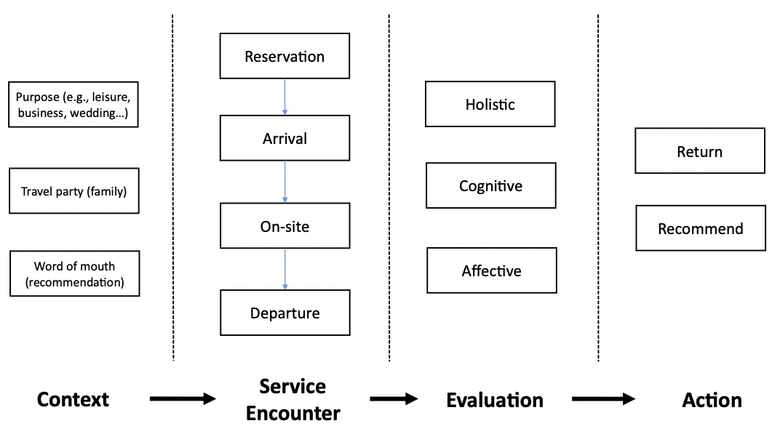
Data Analysis, pre-processing and domain identification
A coding schema was developed to ensure the validity and reliability of extracting words related to hotel guest experience (Fig 3).
Any aspects of user experience were included as a part of the dictionary except:
Stop words
Generic nouns (size, people, effort)
Generic verbs (need, want, like)
High ambiguity words (break, firm, look)
Words relating to hotel brands (Hilton)
Coding stopped when the words encountered were generic and irrelevant.
Fig 3. Coding schema for hotel guest experience
Notes:
To ensure validity and reliability a coding schema was established in order to extract words related to hotel guest experience as shown in Fig. 3.
A comprehensive study was made based on factors such as: (1) the context of guest experience, such as purpose of stay (business, leisure travel, and wedding, etc.), travel party (e.g., family), and reason for the purchase (e.g., due to friends’ recommendation); (2) guests’ verbal evaluation of the experience (e.g., “the staff was very friendly”); and, (3) expression of possible future actions (e.g., “I will recommend this hotel to my friends” or “I will return in the future”). It was believed that a broader perspective would have a better chance to capture the complex nature of personal experience and thus increase the likelihood for it to be related to the guest’s overall satisfaction with a hotel property.
Context of guest experience, purpose of stay, Travel party reason of purchase.
Guest verbal evaluation of experience.
Expression of possible future actions.
Pivot table was used to calculate the frequencies of 416 words against 10537 hotels.

Slide 23
Hotel Guest Experience and Satisfaction
To answer the first research question, factor analysis was conducted to identify the underlying structure of customer reviews.
To answer the second research question, linear regression analysis was used to examine the relationship between guest experience and satisfaction using the factor scores as independent variables and average satisfaction rating as the dependent variable.
Notes:
What is the nature and underlying structure of the hotel guest experience represented in customer reviews?
Can hotel guest experience represented in customer reviews be used to explain guest satisfaction?

Slide 24
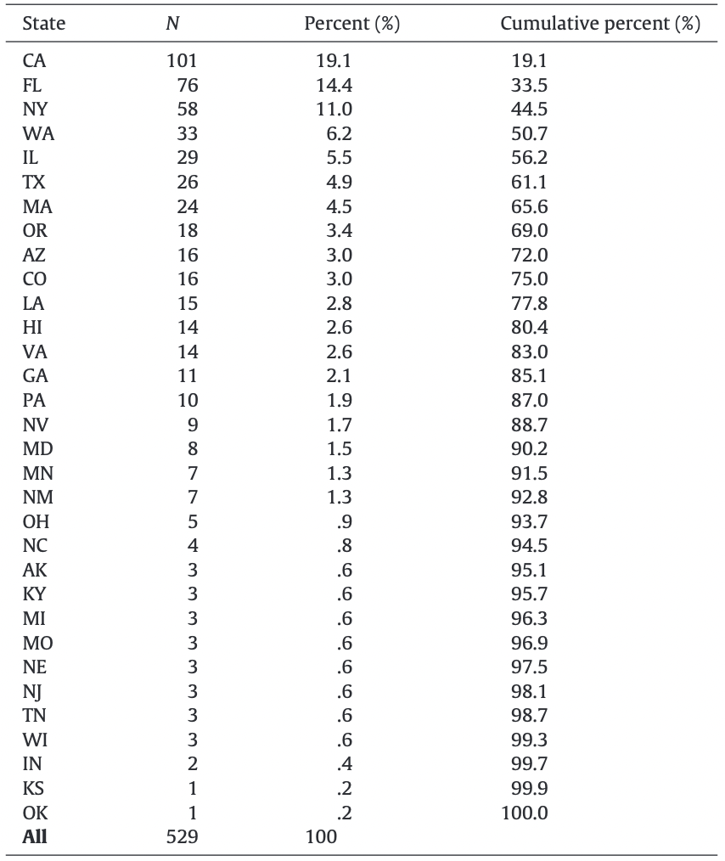
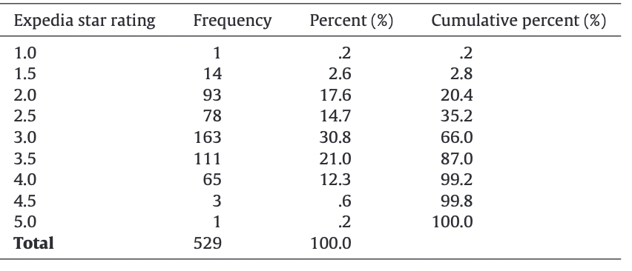
Findings - Table 1 and 2
Table 2: Distribution of hotel properties across US based upon star rating.
Clean data for 529 hotels with 80 reviews (Table 1).
Hotel properties for the top 10 cities in the clean dataset tend to attract more reviews. The distribution is dependent on the volume of tourism and hospitality.
The clean dataset contained a higher percentage of hotels with star ratings from 3 and above.
Customer reviews tend to gravitate towards mid range hotels.
Table 1: Distribution of hotel properties across US used in analysis.
Notes:
This section presents the main findings, in two parts: the first part provides a basic description of the final, “clean” data (with 529 hotel cases and 80 guest experience-related words) while the second part focuses on the statistical analysis that aimed to answer the research questions. Table 1 shows the distribution of the hotel properties across the US and these hotels were located in 32 states. In the final dataset the top 10 cities with most hotels included New York, San Francisco, Orlando, San Diego, Seattle, Chicago, Boston, Miami, Portland, and Anaheim. Interestingly, the top ten cities in the clean dataset had nearly 60% of the total number of properties while the top 10 in the original dataset contained only 34% of all hotel properties. This suggests that hotel properties in the top 10 cities in the clean dataset tended to attract more customer reviews, at least in the case of Expedia.com.
Table 2 shows the distribution of hotel properties based upon star ratings.. As can be seen, hotels with star rating from 2-4 constituted more than 96% of all hotels. An observable difference between these two datasets is that the clean dataset contained a higher percentage of hotels with a higher star rating (three and above). This seems to indicate that, while there were apparently more mid-range hotel properties than basic hostels/dormitories (below two stars) or luxury hotels (above four stars), customer reviews in Expedia.com tended to gravitate toward the mid-range hotels. Average satisfaction rating of hotels in the clean dataset is almost similar to the original dataset with a mean of 3.9

Slide 25
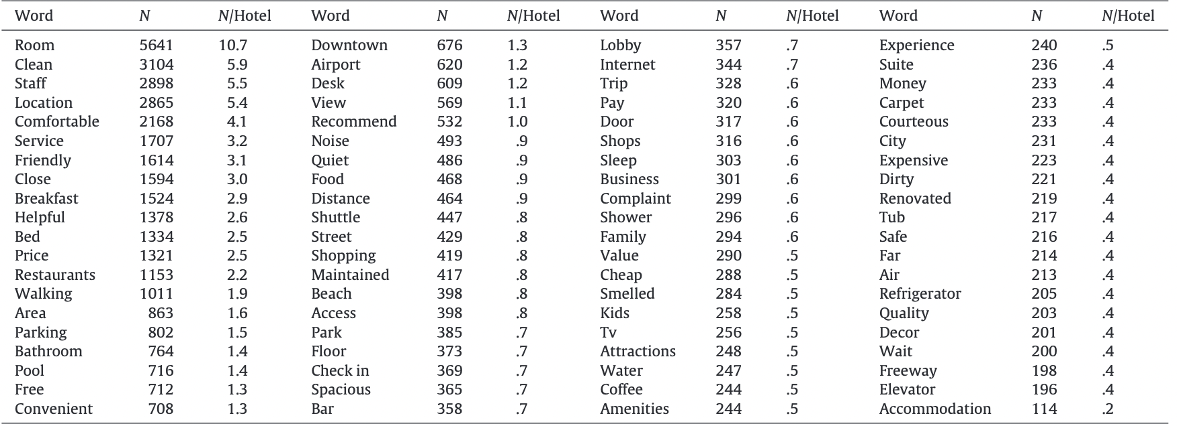
Findings - Table 3
Table 3 explains satisfactory ratings along with total and average frequency per hotel.
The frequency distribution is highly skewed.
These 80 words reflects a diverse array of amenities, attributes and service at the aggregate level.
Table 3: Top 80 primary words in hotel customer reviews
Notes:
Table 3 provides the list of the 80 guest experience-related words that were used to explain satisfaction ratings along with their total frequency and average frequency per hotel. These words reflect a wide spectrum of aspects related to the hotel guest experience, including (1) the very core product such as “room”, “bed”, and “bathroom”; (2) hotel amenities such as “front” (desk), “restaurant”, “pool”, “parking”, hotel attributes such as “location” and so on. The frequency distribution of these 80 words is highly skewed, in that the top 12 words constitute more than half, and the top 25 words nearly 70%, of the total frequency of all words. This distribution can be characterized as one with a “head”, i.e., word with relatively high frequencies, and a “long tail”, i.e., those with low frequencies. The “head” words center around the core and basic products/services as well as attributes such as the guest room, cleanliness, staff and, location. The “long tail” words reflects on other important areas of guest experience.

Slide 26
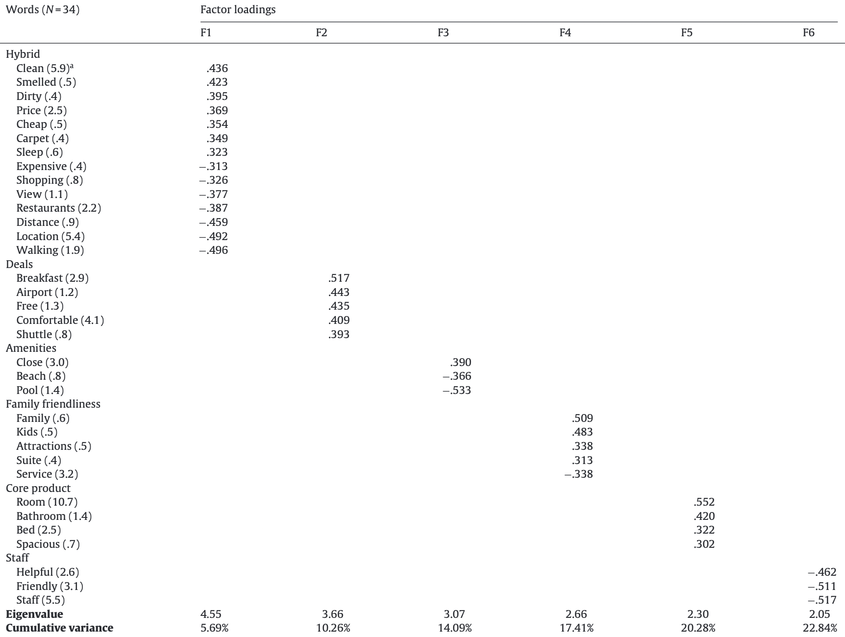
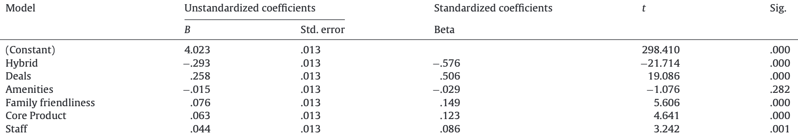
Findings - Table 4 and 5
Table 5: Results of Linear Regression Analysis
Six meaningful factors consisting 34 from 80 words were extracted from factor analysis (Table 4).
Two groups of words have opposite signs in their loadings, indicating that their meanings are different in context.
It is unlikely that a customer will use words from the second group if he/she uses a word from the first group.
The average satisfaction rating is the dependent variable, with six hotel guest experience factors as independent variables, as per the ANOVA results (Table 5).
Hybrid and Deals are considered to be the most important associated with customer satisfaction with coefficients -0.567 and 0.506.
Table 4: Factor loadings of words > 30
Notes:
Factor analysis was used to examine the underlying semantic structure and further reduce the number of words from the data matrix into meaningful groupings of words, that would be easier to interpret. As can be seen in Table 4, by factor analysis six meaningful factors consisting of 34 words out of the final 80 words from Table 3 emerged.
the cutoff eigenvalue was set at 2 because, as the number of factors increases, the more difficult it becomes to interpret those “small” factors. The first factor, containing 14 words, was named “Hybrid” because it appears to be comprised of two distinctive groups of words that represent very different hotel guest experiences. The first group of words, including “clean”, “smelled”, “dirty”, seemed to be dominated by maintenance-related aspects which could affect the guest’s basic needs (“sleep”). The second group of words, including “expensive”, “distance”, “location”, and “walking”, seemed to represent the experiential aspects of the hotel stay, particularly in words such as “shopping”, “restaurant”, “location”, “walking”, and “view”. These two groups have opposite signs in their loadings. That is, when a consumer mentions the words in the first group, he/she is unlikely to use words in the second group to describe the experience.
Table 5 shows the ANOVA results using average satisfaction rating as the dependent variable and the six hotel guest experience factors as independent variables. All factors except Amenities were significant at the p = .01 level,. Hybrid and Deals have the largest standardized coefficients of −.567 and .506, respectively. This suggests that Hybrid and Deals are the most important factors associated with guest satisfaction. Interestingly, the factor Core Product, although significant, was not as important as Hybrid, Deals, and Family Friendliness. Since the factor loadings of the Hybrid maintenance and cleanliness-related words are positive while the factor loadings of the Hybrid experiential words are negative, this means that this factor carries a negative “sentiment”: if satisfaction rating is low, hotels reviewed by Expedia customers tend to be NOT well maintained and did NOT support experience co-creation by the customer. In case of Deals being positive, it means that a high satisfaction rating is associated with the mentions of words such as free services like breakfast.

Slide 27
Conclusion
Text analytics was applied to classify large quantities of customer reviews, assess data quality and identify inherent relationships between two domains of variables in hotel management.
The importance of hygiene factors in hotel services cannot be overlooked.
If the hotel has a low satisfaction rating on Expedia.com, it is likely that it is poorly maintained and does not support customer experience co-creation.
Apart from spacious rooms or attractions, guests staying with family members are usually uninterested in the hotel's service.
Hybrid approaches exist for Shallow and Deep NLP processing.
Link to hybrid NLP paper: https://www.researchgate.net/publication/2490166_An_Integrated_Architecture_for_Shallow_and_Deep_Processing
Notes:
Hotel guest experience and satisfaction have been extensively studied in the hospitality management literature. Guest experience is, undoubtedly, an extremely complex construct. Depending upon the research design and methods researchers could get very different pictures of what constitutes guest experience and what actually leads to guest satisfaction. The Hybrid factor appears to be dominant and quite complex in its own and counterintuitive at first.

Slide 28
References
High, R. (2012). The era of cognitive systems: An inside look at IBM Watson and how it works. IBM Corporation, Redbooks, 1-16.
Xiang, Z., Schwartz, Z., Gerdes Jr, J. H., & Uysal, M. (2015). What can big data and text analytics tell us about hotel guest experience and satisfaction?. International Journal of Hospitality Management, 44, 120-130.

